Slide 1
PROJECT Housing
PRESENTATION
Houses are one of the necessary need of each and every person around the globe and therefore housing and real estate market is one of the markets which is one of the major contributors in the world’s economy. It is a very large market and there are various companies working in the domain
Submitted by Dattatraya Panda

Slide 2
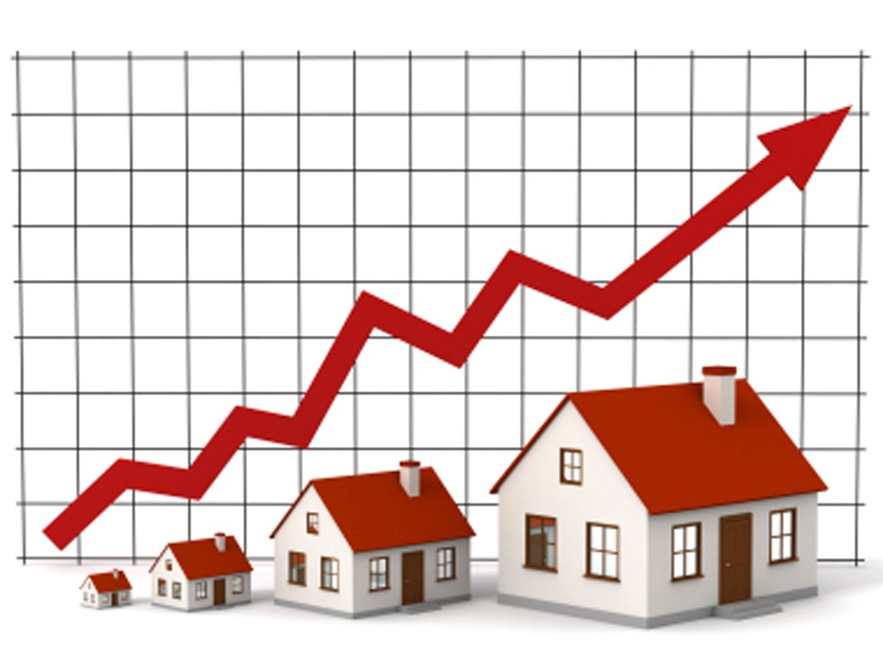
HOUSING SALE PRICE PREDICTION PROJECT

Slide 3
ACKNOWLEDGMENT
I Would like to thanks my sme Mohd Kashif and Flip Robo Technologies As they give the poject
I use some website to help me in this project
1) https://www.google.com/
2) https://www.youtube.com/
3) https://github.com/
4) https://scikit-learn.org/stable/

Slide 4
INTRODUCTION
Surprise Housing is a US based Real estate and housing company who is trying to entry into Australian Real estate market. The company is looking at prospective properties to buy houses to enter the market. We are required to build a model using Machine Learning in order to predict the actual value of the prospective properties and decide whether to invest in them or not.
For this Surprise Housing wants to know:
what are the important variables to predict the sale price of house?
How do these feature variables describe the price of the house?

Slide 5
AGENDA
Analytical Problem Framing
Exploratory Data Analysis (EDA)
Visualizations
Data Pre-Processing on train and test datasets
Model/s Development and Evaluation
Performing hyper parameter tuning, saving the best model and predicting the label
Conclusion and future work discussion

Slide 6
Hardware - Software Requirements and Tools Used
Hardware Used:
Processor: Core i5 -10300H CPU
RAM: 8 GB
Operating System: 64-bit
ROM/SSD: 512 TB SSD
Graphics: NVIDIA GeForce GTX 1650 Ti

Slide 7
Hardware - Software Requirements and Tools Used
Software Used:
Programming language: Python
Distribution: Anaconda Navigator
Browser based language shell: Jupyter Notebook
Libraries/Packages Used:
Pandas, NumPy, matplotlib, seaborn, scikit-learn and
pandas_profiling

Slide 8
PROBLEM STATEMENT
Houses are one of the necessary need of each and every person around the globe and therefore housing and real estate market is one of the markets which is one of the major contributors in the world’s economy. It is a very large market and there are various companies working in the domain.
Data science comes as a very important tool to solve problems in the domain to help the companies increase their overall revenue, profits, improving their marketing strategies and focusing on changing trends in house sales and purchases.
Predictive modelling, Market mix modelling, recommendation systems are some of the machine learning techniques used for achieving the business goals for housing companies. Our problem is related to one such housing company.

Slide 9
ANALYTICAL PROBLEM FRAMING
As we are provided with two sets of data, one is for training and other for testing. Here we need to build a machine learning model using train dataset and then by using that model we will make predictions for test dataset.
Both the datasets are in csv format, train dataset has 1168 rows and 81 columns whereas test dataset has 292 rows and 80 columns. Here in the test dataset we do not have the target label and need to predict the same.
And as we have to predict house sale prices in this problem which is a continuous data, I will be using different regression machine learning models.

Slide 10
DATA PRE PROCESSING
Importing the necessary libraries.
Reading the CSV file and converted into data frame.
Checking the data dimensions for the original dataset.
Looking for null values and accordingly fill the missing data.
Checking the summary of the dataset.
Checking unique values.
Checking all the categorical columns in the dataset.
Visualizing each features using matplotlib and seaborn.
Performing encoding using the ordinal encoder on categorical features.

Slide 11
DATA PRE PROCESSING
Checking for correlation/multi-collinearity in a heatmap.
Checking for Outliers/Skewness using box plot and distribution plot.
Removing Skewness using yeo-johnson power transform method only on selected numerical columns.
Perform Scaling using Standard Scaler method.
Checking Multicollinearity using VIF Factor and dropping high VIF columns
Checking for the final dimension of dataset to confirm the input details.
Creating train test split and the best random state found in the range 1-1000.

Slide 12
EXPLORATORY DATA ANALYSIS (EDA) AND VISUALIZATION
01. Univariate Analysis
02. Multivariate Analysis
03. Correlation of Dataset
Univariate analysis is the simplest form of analyzing data. “Uni” means “one”, so in other words your data has only one variable.
Multivariate analysis is a set of statistical techniques used for analysis of data that contain more than one variable.
Correlation is used to test relationships between quantitative variables or categorical variables.
04. Correlation with Target variable
05. Conclusion
Correlation with the target variable to know how the data is related.
Summary with the conclusion of all the analysis

Slide 13
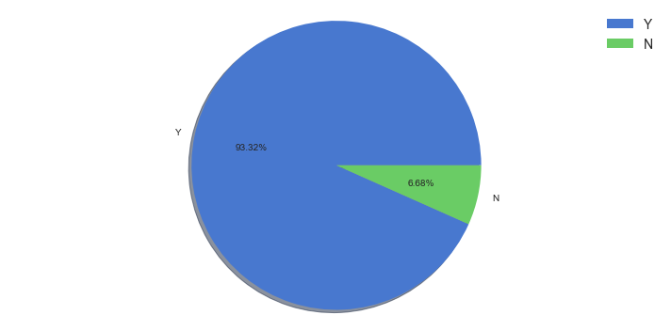
PIE PLOT
A Pie Chart is a circular statistical plot that can display only one series of data.
The area of the chart is the total percentage of the given data.
The area of slices of the pie represents the percentage of the parts of the data.

Slide 14
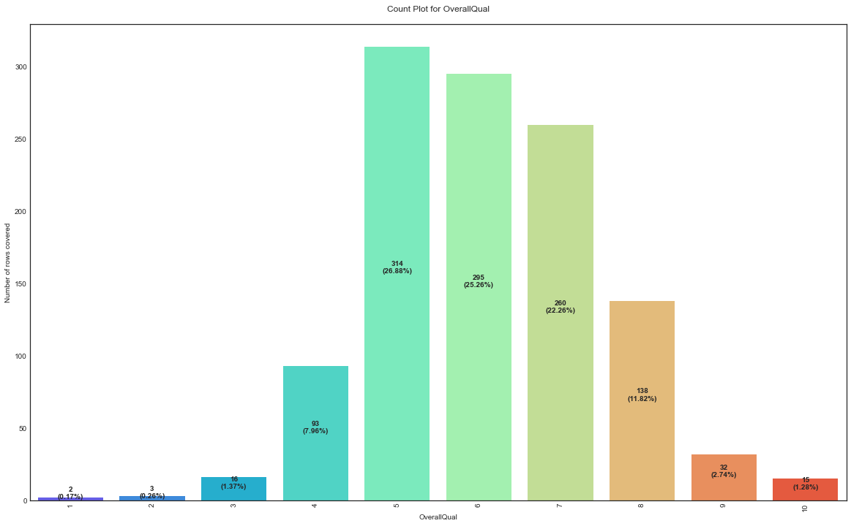
COUNT PLOT
Count plot method is used to show the counts of observations in each categorical bin using bars.
Parameters : This method is accepting the following parameters that are described below: x, y
This parameter take names of variables in data or vector data.

Slide 15
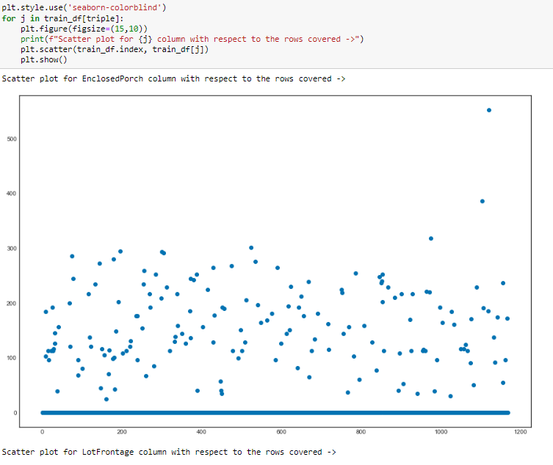
SCATTER PLOT
Scatter plots are used to observe relationship between variables and uses dots to represent the relationship between them.
The scatter method in the matplotlib library is used to draw a scatter plot.
Scatter plots are widely used to represent relation among variables and how change in one affects the other.

Slide 16
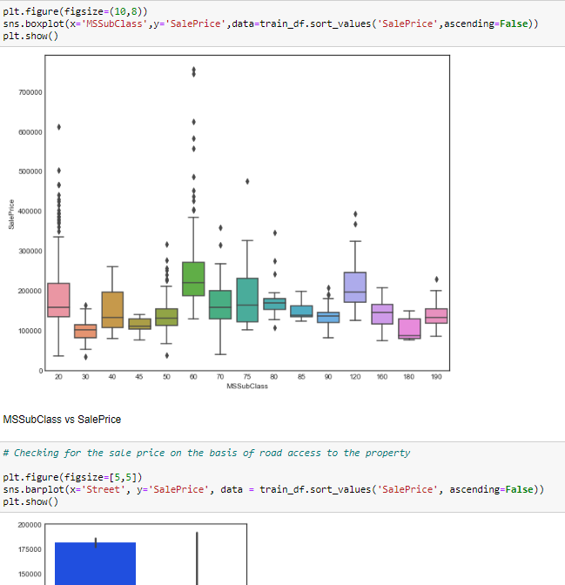
Bivariate Analysis (Independent variables vs Target Variable):
Bivariate analysis helps in finding out the relation of one variable with respect to the other variables.
In our project we have used this to see the relation between some of our Independent Variables and our target variables.

Slide 17
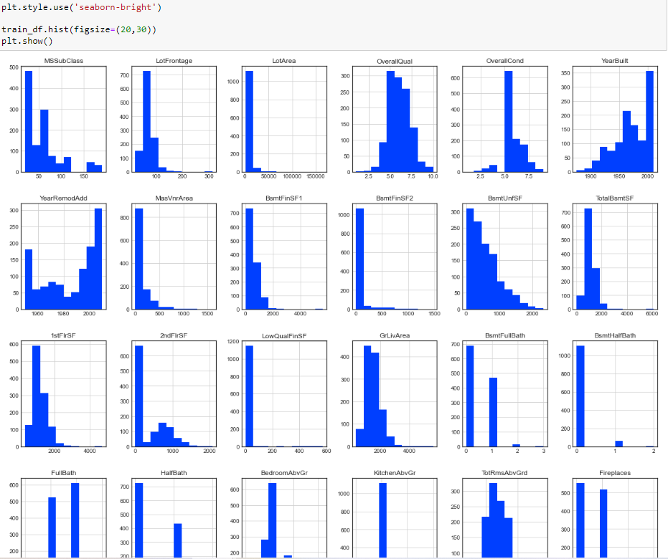
HISTOGRAM
A histogram is basically used to represent data provided in the form of some groups.
It is accurate method for the graphical representation of numerical data distribution.
It is a type of bar plot where X-axis represents the bin ranges while Y-axis gives information about frequency.

Slide 18
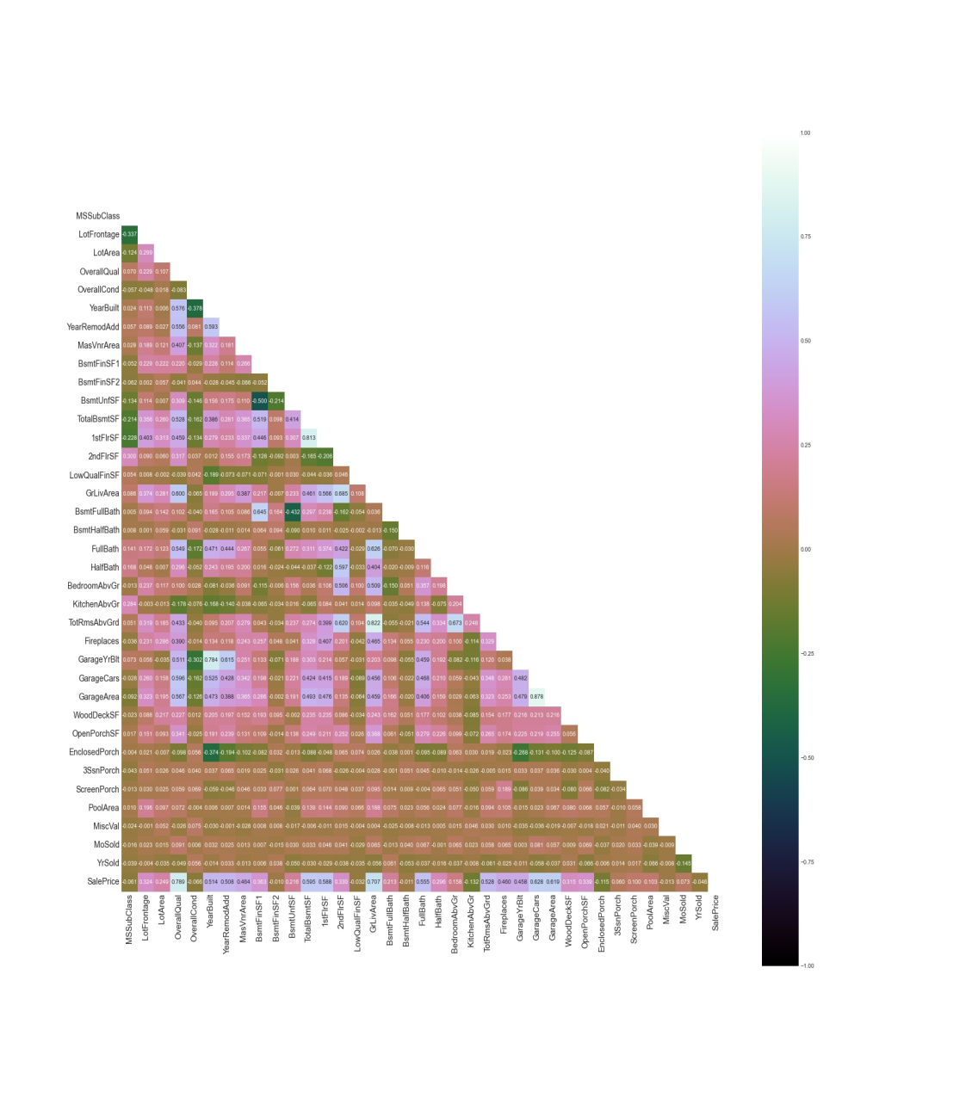
HEATMAP
A heatmap contains values representing various shades of the same color for each value to be plotted.
Usually the darker shades of the chart represent higher values than the lighter shade.

Slide 19
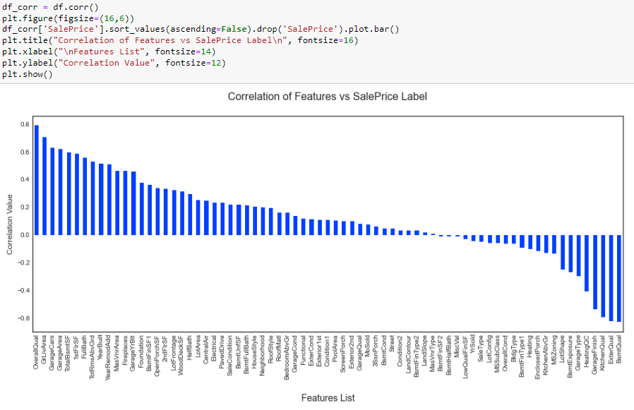
BAR GRAPH
Bar graphs are used to compare things between different groups or to track changes over time.
Here we are comparing the correlation values between the feature columns and the target label column which is Sale Price in our scenario.
It gives us an insight on positive and negative correlated column details.

Slide 20
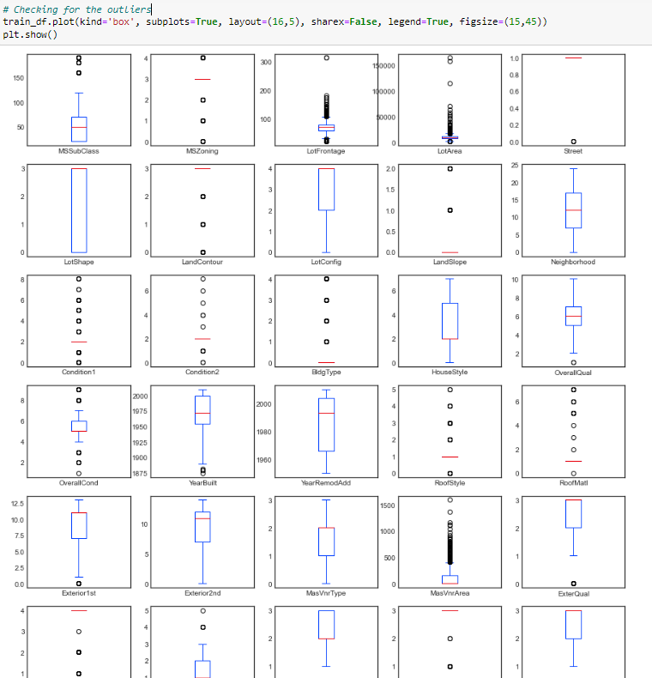
BOX PLOT
A Box Plot is also known as Whisker plot is created to display the summary of the set of data values having properties like minimum, first quartile, median, third quartile and maximum.
We have used it to identify the outlier details for all the numeric datatype column values.

Slide 21
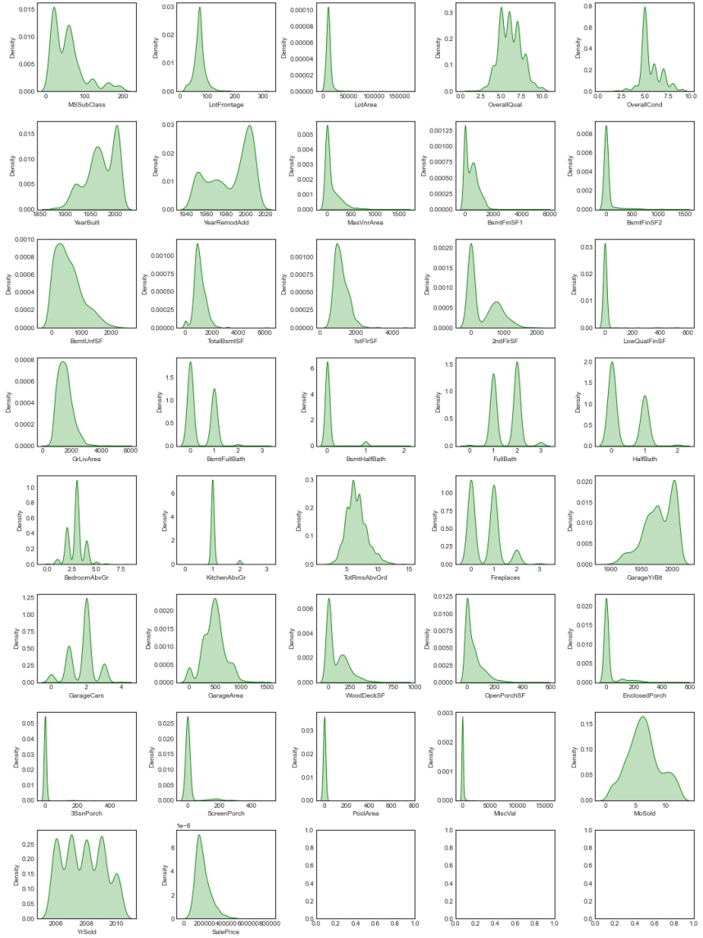
DISTRIBUTION PLOT
Distribution plots visually assess the distribution of sample data by comparing the empirical distribution of the data with the theoretical values expected from a specified distribution.
Here we have used it to analyze the skewness information for numeric datatype column values.
The acceptable form usually is a normal distribution resembling a bell shape curve.

Slide 22
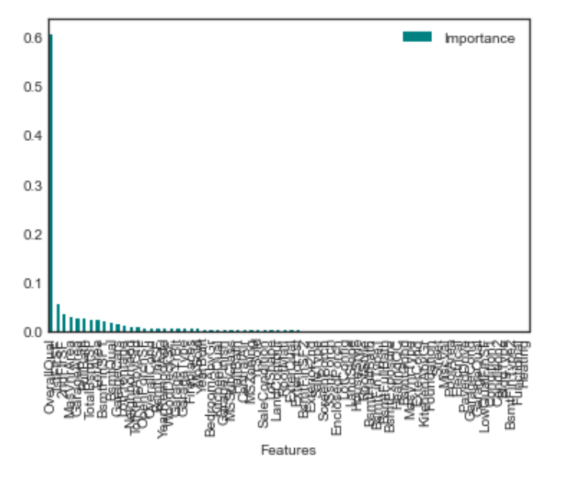
Feature Importance with respect to Target variable:
Here in Feature Importance with respect to Target variable we can see the bar plot which shows which feature is more important in predicting the target variable.

Slide 23
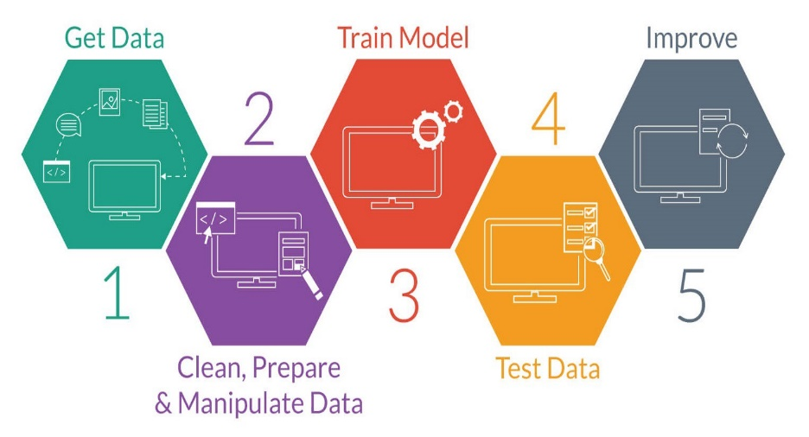
MODEL TRAINING PHASES

Slide 24
MODEL/S DEVELOPMENT
The algorithms used on training and test data are as follows:
Linear Regression Model
Ridge Regularization Regression Model
Lasso Regularization Regression Model
Elastic Net Regularization Regression Model
Support Vector Regression Model
Decision Tree Regression Model
Random Forest Regression Model
K Nearest Neighbours Regression Model
Stochastic Gradient Descent Regression Model
Gradient Boosting Regression Model
Ada Boost Regression Model
Extra Trees Regression Model

Slide 25
EVALUATION AND HYPER PARAMETER TUNING
The key metrics used here were:
R2 score
Cross Validation Score
MAE
MSE
RMSE
We tried to find out the best parameters list to increase our accuracy scores by using Hyperparameter Tuning.
In order to achieve a higher score we used the Grid Search CV method with 5 folds.

Slide 26
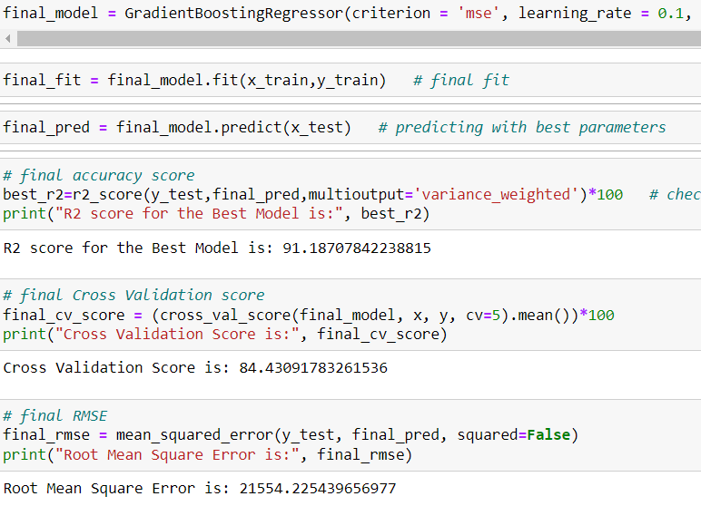
FINALISED MODEL
We used Hyper Parameter Tuning on the final model to obtained the best r2_score and CV score.

Slide 27

FINALISED MODEL
Saving the model in pickle Format for further use to predict the Target variables.
Saving the best regression model using pickle

Slide 28
THANK YOU

